Slide 1
Programming for problem solving
Presented by,
Devipriya M
Assistant professor
SRM IST Trichy

Slide 2
Program
A program is a set of instructions for the computer to follow. The machine can’t read a program directly, because it only understands machine code.
But you can write code in a computer language, and then a compiler or interpreter can make it understandable to the computer.

Slide 3
Evolution of programming languages
Programming language is the fundamental unit of today’s tech world.
The set of commands and instructions that we give to the machines to perform a particular task.
There are 500 + programming languages available.
First programmer is Ada Lovelace.
In 1883, Ada programmed the analytical engine.
In 1949, Assembly language is developed. It is a low level language. It consists of instructions that only machine can understand.
Assembly languages are used in simulation flight navigation systems, medical equipment, to create virus.

Slide 4
Evolution contd..
In 1952, Autocode is developed by Alick glennie. The first complied computer programming language.
In 1957, FORTRAN is developed by John Backus and IBM. It was designed for numeric computation and scientific computing.
In 1958, ALGOL (ALGOrithmic Language) is developed. It was also the first language implementing the nested function and has a simple syntax than FORTRAN.
In 1959, COBOL (COmmon Business-Oriented Language) is developed. In 1997, 80% of the world’s business ran on Cobol.

Slide 5
Evolution contd.
In the 1960s, the term autocoders was used more generically as to refer to any high-level programming language using a compiler.
The US internal revenue service scrambled its path to COBOL-based IMF (individual master file) in order to pay the tens of millions of payments mandated by the coronavirus aid, relief, and economic security.
In 1964, BASIC (beginners All-purpose symbolic instruction code) is developed.
In 1991, Microsoft visual basic is develop as updated BASIC. It is developed by Bill gates, paul allen and Monte Davidoff.

Slide 6
Evolution contd.
In 1972, C language is developed. It is a general-purpose, procedural programming language and the most popular programming language till now.
All the code that was previously written in assembly language gets replaced by the C language like operating system, kernel, and many other applications.
C is the mother of almost all higher-level programming languages like C#, D, Go, Java, JavaScript, Limbo, LPC, Perl, PHP, Python, and Unix’s C shell.

Slide 7
Evolution contd.
Year | Programming languages | Facts
1972 | SQL | Storing, manipulating and retrieving data in databases.
1978 | MATLAB | Multi-paradigm programming language and numeric computing environment
1983 | Objective C, C++ | To create high-performance applications
1990 | Haskel | Functional programming language
1991 | Python | Functional programming language, Data science
1995 | JAVA, PHP, Javascript | Building software, Web development.
2000 | C# | Building games
2009 | GO | open source programming language
2011 | Kotlin | Creating Android apps
2014 | Swift | General-purpose programming language.

Slide 8
Programming for problem solving
Program Analysis
• Understand the problem
• Have multiple solutions
• Select a solution
Program Design
• Write Algorithm
• Write Flowchart
•Write Pseudo code

Slide 9
Programming for problem solving
Program Development
• Choose a programming language
• Write the program by converting the pseudo code, and using the
programming language.
• Compile the program and remove syntax errors, if any
• Execute the program.
• Test the program. Check the output results with different inputs. If the
output is incorrect, modify the program to get correct results.
• Install the tested program on the user’s computer.

Slide 10
Programming for problem solving
Program Documentation and
maintenance
• Document the program, for later use.
• Maintain the program for updating, removing errors, changing
requirements etc.

Slide 11
Creating algorithms
Algorithm is an ordered sequence of finite, well defined, unambiguous instructions for completing a task.
Algorithm is an English-like representation of the logic which is used to solve the problem.
It is a step- by-step procedure for solving a task or a problem.
For accomplishing a particular task, different algorithms can be written.
The programmer selects the best-suited algorithm for the given task to be solved.

Slide 12
Algorithm to find the greatest among three numbers
Step 1: Start
Step 2: Read the three numbers A, B, C
Step 3: Compare A and B. If A is greater perform step 4 else perform step 5.
Step 4: Compare A and C. If A is greater, output “A is greatest” else output “C is greatest”. Perform step 6.
Step 5: Compare B and C. If B is greater, output “B is greatest” else output “C is greatest”.
Step 6: Stop

Slide 13
Flowchart
Flowchart is a visual representation of the sequence of steps for solving a problem.
It enlightens the way what comes first, second and so on.
It enables us to organize a problem into plan of actions.
Instead of descriptive steps, we use pictorial representation for every step.
For every process, there is a corresponding symbol in the flowchart.

Slide 14
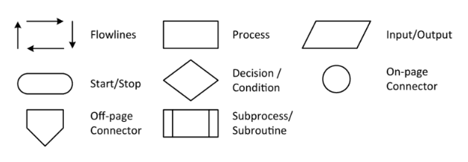
Flowchart symbols

Slide 15
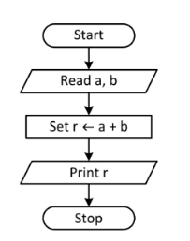
Flow chart for addition

Slide 16
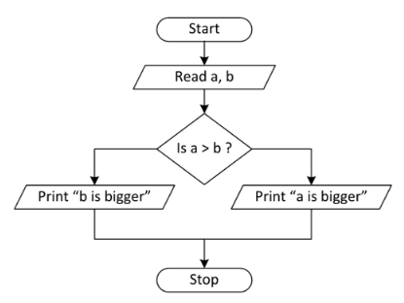
Flow chart to find big number
No
Yes

Slide 17
Pseudocode
It is one of the methods which can be used to represent an algorithm for a program.
It does not have a specific syntax like any of the programming languages and thus cannot be executed on a computer.
There are several formats which are used to write pseudo-codes and most of them take down the structures from languages such as C, Lisp, FORTRAN, etc.

Slide 18
Pseudocode
Many time algorithms are presented using pseudocode since they can be read and understood by programmers who are familiar with different programming languages.
Pseudocode allows you to include several control structures such as If-then-else, Repeat-until, for and case, While, which is present in many high-level languages.
Note: Pseudocode is not an actual programming language.

Slide 19
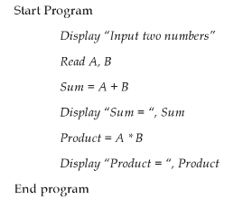
Pseudocode to add and multiply

Slide 20
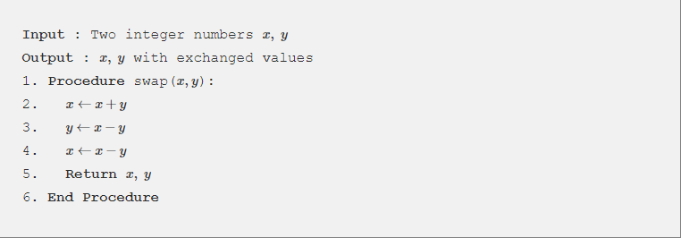
Pseudocode to swap two numbers

